Slide 1


HEP NTUA Top Angular Report 24/3/2021
George Bakas

Slide 2
Summary
Signal Region is now the same with ttX analysis:
mJJ > 1000 GeV
Angular distribution integration
Stack histograms: (m_{Z’}: 1.2, 1.4, 1.6, 1.8, 2, 2.5, 3, 3.5, 4, 4.5 TeV width 1%)
Year 2017
Data vs MC (qcd scaled with k-factor to data)
TTbar scaled with signal strength
mJJ and chi
Asymptotic Limits (Brazilian plots)
2017 and 2018
Comparison with the B2G-16-015 results

Slide 3
Stack Histograms mJJ
M_{z’} =1200, w = 1%
M_{z’} =1600, w = 1%
M_{z’} =1400, w = 1%
M_{z’} =1800, w = 1%

Slide 4
Stack Histograms mJJ
M_{z’} =2000, w = 1%
M_{z’} =3000, w = 1%
M_{z’} =2500, w = 1%
M_{z’} =3500, w = 1%

Slide 5
Stack Histograms mJJ
M_{z’} =4000, w = 1%
M_{z’} =4500, w = 1%

Slide 6
Stack Histograms chi
M_{z’} =1200, w = 1%
M_{z’} =1600, w = 1%
M_{z’} =1400, w = 1%
M_{z’} =1800, w = 1%

Slide 7
Stack Histograms chi
M_{z’} =2000, w = 1%
M_{z’} =3000, w = 1%
M_{z’} =2500, w = 1%
M_{z’} =3500, w = 1%

Slide 8
Chi (χ) sensitivity
M_{z’} =1200, w = 1%
M_{z’} =1600, w = 1%
M_{z’} =1400, w = 1%
M_{z’} =1800, w = 1%

Slide 9
Chi (χ) sensitivity
M_{z’} =2000, w = 1%
M_{z’} =3000, w = 1%
M_{z’} =2500, w = 1%
M_{z’} =3500, w = 1%

Slide 10
Chi (χ) sensitivity
M_{z’} =4000, w = 1%
M_{z’} =4500, w = 1%

Slide 11
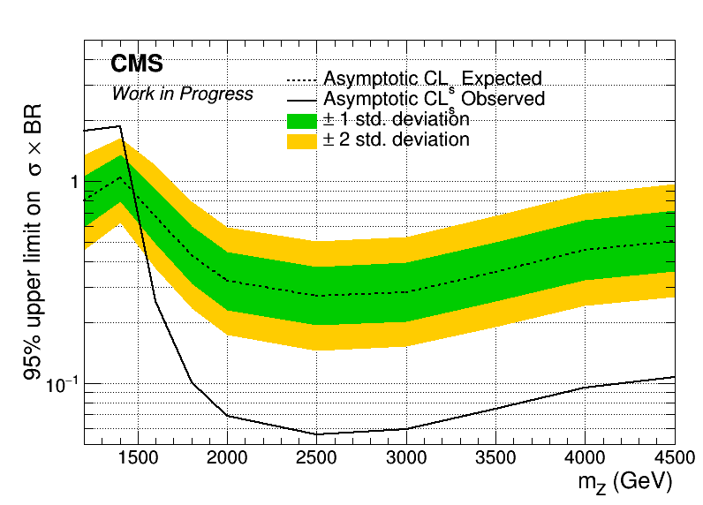
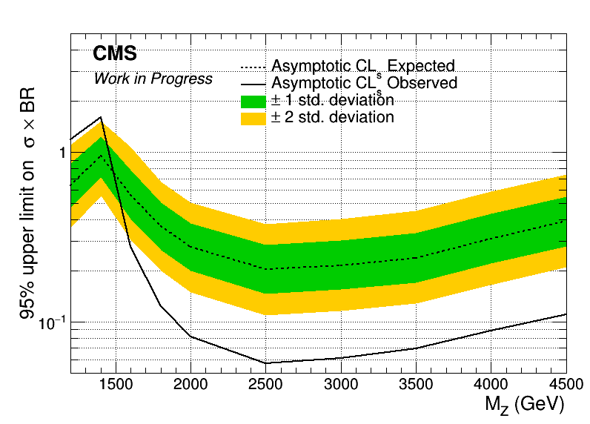
Angular Distributions (Brazilian Plot)
Assymptotic limits for M Z’: 1.2, 1.4, 1.6, 1.8, 2, 2.5, 3, 3.5, 4, 4.5 TeV
Width 1%
2017
2018

Slide 12
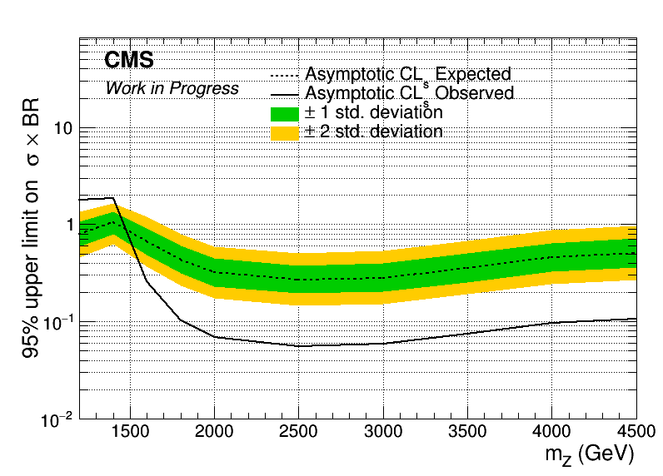
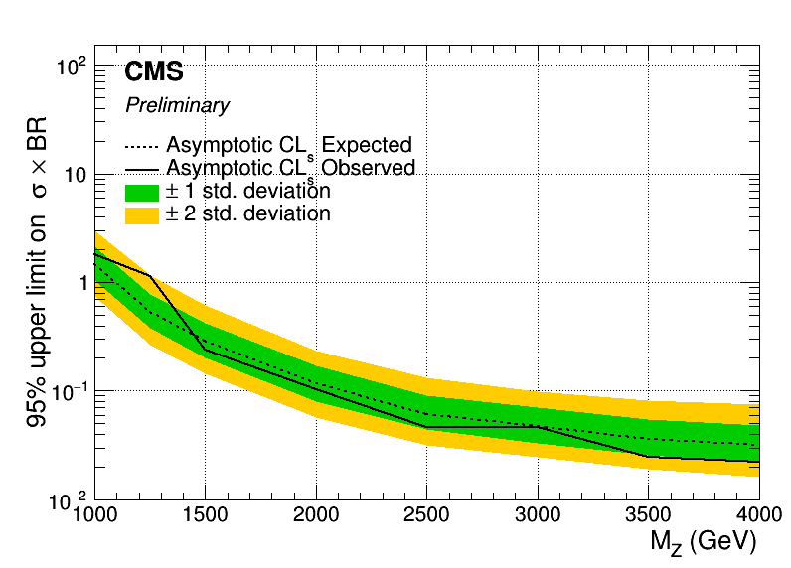
Angular Distributions (Brazilian Plot) vs B2G-16-015
Assymptotic limits for M Z’: 1.2, 1.4, 1.6, 1.8, 2, 2.5, 3, 3.5, 4, 4.5 TeV
Width 1%
2017
B2G-16-015

Slide 13
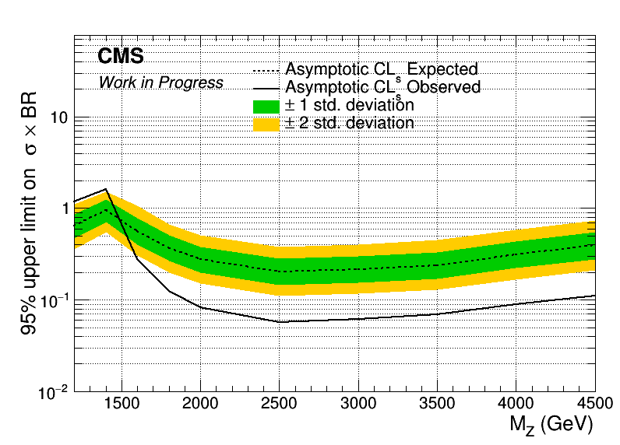
Angular Distributions (Brazilian Plot) vs B2G-16-015
Assymptotic limits for M Z’: 1.2, 1.4, 1.6, 1.8, 2, 2.5, 3, 3.5, 4, 4.5 TeV
Width 1%
2018
B2G-16-015

Slide 14
BACKUP

Slide 15
Signal Selection
Control Region Selection
Variables | Selected Cut
pT (both leading jets) | > 400 GeV
Njets | > 1
N leptons | = 0
|eta| (both leading jets) | < 2.4
mJJ | > 1000 GeV
jetMassSoftDrop (only for fit) | (50,300) GeV
Top Tagger | > 0.2, 0, 0.1
B tagging (2 btagged jets) | > Medium WP
Signal Trigger
Variables | Selected Cut
pT (both leading jets) | > 400 GeV
Njets | > 1
N leptons | = 0
|eta| (both leading jets) | < 2.4
mJJ | > 1000 GeV
jetMassSoftDrop (only for fit) | (50,300) GeV
Top Tagger | > 0.2, 0, 0.1
B tagging (0 btagged jets) | < Medium WP
Control Trigger

Slide 16
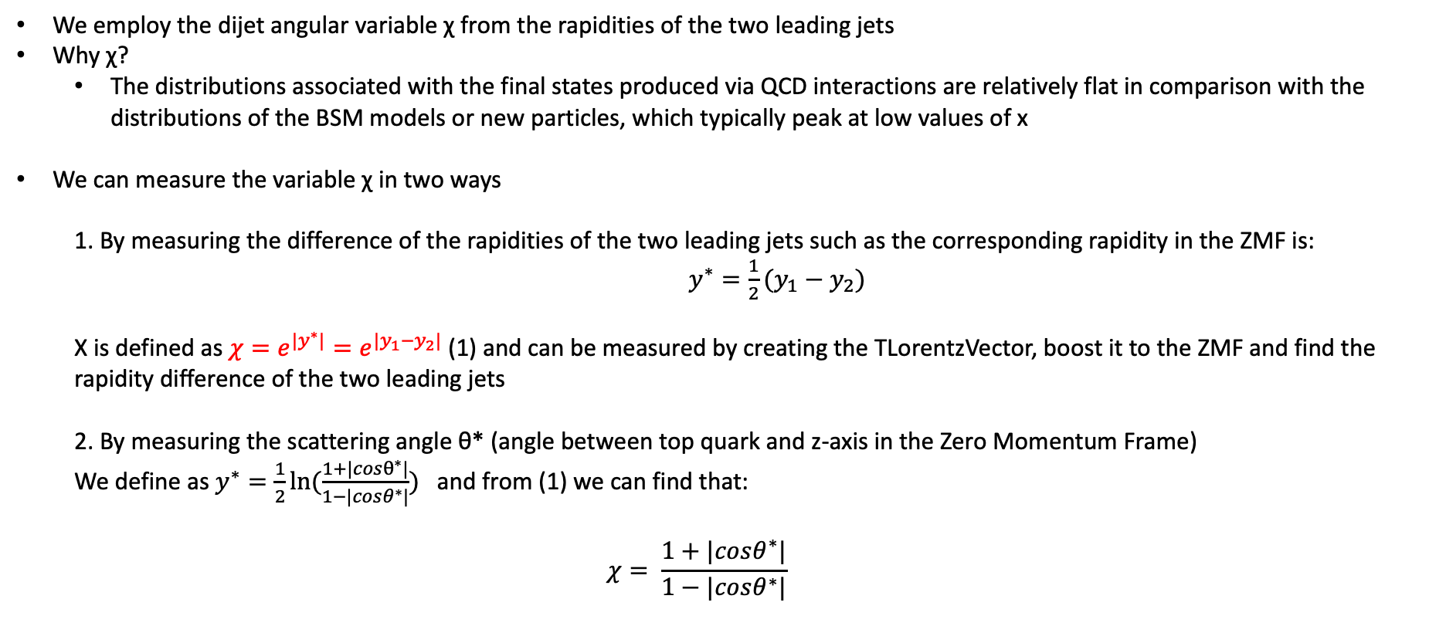
Top Angular Distributions
We employ the dijet angular variable χ from the rapidities of the two leading jets
Why χ?
The distributions associated with the final states produced via QCD interactions are relatively flat in comparison with the distributions of the BSM models or new particles, which typically peak at low values of x
We can measure the variable χ in two ways
1. By measuring the difference of the rapidities of the two leading jets such as the corresponding rapidity in the ZMF is: $y^{∗}=\frac{1}{2}(y_{1}−y_{2})$
Χ is defined as $χ=e^{{|y}^{∗}|}=e^{|y_{1}−y_{2}|}$ (1) and can be measured by creating the TLorentzVector, boost it to the ZMF and find the rapidity difference of the two leading jets
2. By measuring the scattering angle θ* (angle between top quark and z-axis in the Zero Momentum Frame)
We define as $y^{∗}=\frac{1}{2}ln⁡(\frac{1+|cosθ^{∗}|}{1−|cosθ^{∗}|})$ and from (1) we can find that:
$$χ= \frac{1+|cosθ^{∗}|}{1−|cosθ^{∗}|}$$

